Slide 1

Nmap and Network Scanning
Abrudan Rebeca Rafaela

Slide 2
Table of contents
Introduction (network scanning, network security and nmap)
History and Purpose
How does Nmap work
Nmap Features
Demonstration
Bibliographical references

Slide 3

Introduction Network Scanning
Network scanning is a procedure for identifying active hosts, open ports, services and devices on a computer network.
It involves sending data packets to analyze network responses.
Network scanning is used in monitoring and management, but it can be also used to exploit the weaknesses within a network

Slide 4
Network Security
Network security is the practice of keeping data safe and making sure the network stays reliable
It involves protecting networks from external threats, including unauthorized access, viruses, malware, denial of service attacks, spam

Slide 5
Nmap
created by Gordon “Fyodor” Lyon
released in 1997
one of the most widely used and respected network scanning tools
designed to rapidly scan large networks

Slide 6
How does Nmap work
It uses raw IP packets to determine what hosts are available on the network, what services (application name and version) those hosts are offering, what os (and the os versions) they are running
The simple command nmap <target> scans 1,000 TCP ports on the host <target>
The output is a list of scanned targets.
“interesting ports table”
Port number
Service name
State: open, filtered, closed, unfiltered

Slide 7
Target Host
Everything on the command line that isn’t an option is treated as a target host specification.
Targets can be specified using IP addresses, hostnames, CIDR notation, or octet ranges.
Appending /<numbits> to an IP address/hostname => scan every IP address
Ex: 192.168.10.0/24 => scan 256 hosts (192.168.10.0-192.168.10.255)
If we want to skip IPs ending with .0 or .255 (subnet and broadcast addresses) => octet range addressing
Ex: 192.168.0-255.1-254 will skip all addresses in the range that end in .0 or .255

Slide 8
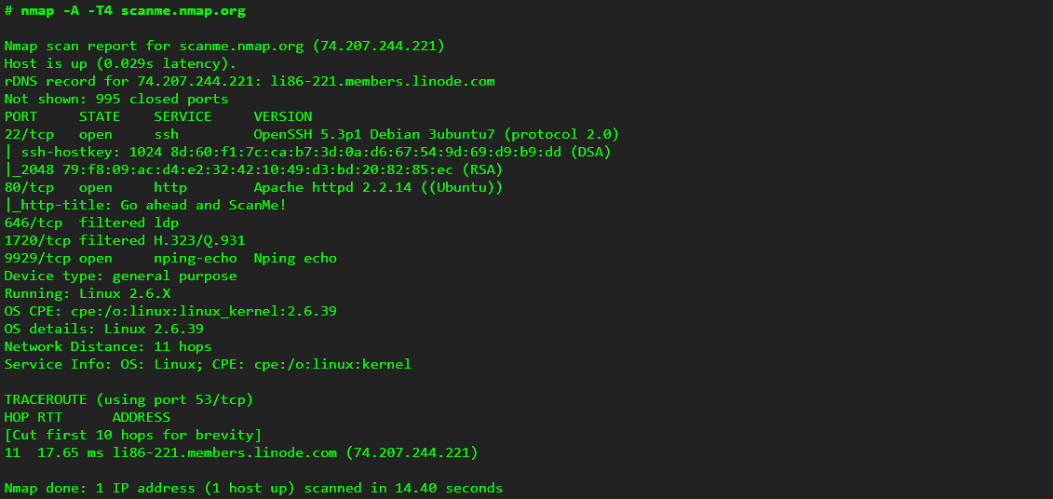
Arguments:
-A to enable OS and version detection, script scanning, and traceroute;
-T4 for faster execution;
-the hostname
The target host
The reverse DNS record
The ports table
Device and OS info
Network distance
Service info
Traceroute

Slide 9
Now let’s try some examples on the host scanme.nmap.org:
nmap –sn = host discovery
nmap = basic port scan
nmap –sV = service version detection
nmap –A = aggressive scan
nmap --script=default
nmap –v = verbose output
nmap –sS = stealthy scan

Slide 10
Bibliographical references
https://nmap.org
https://www.techtarget.com/searchnetworking/definition/network-scanning#:~:text=Network%20scanning%20is%20a%20procedure,devices%20and%20await%20a%20response
https://www.blumira.com/using-nmap/
https://www.freecodecamp.org/news/what-is-nmap-and-how-to-use-it-a-tutorial-for-the-greatest-scanning-tool-of-all-time/

Slide 11
Thank you for watching
Abrudan Rebeca Rafaela

